Slide 1
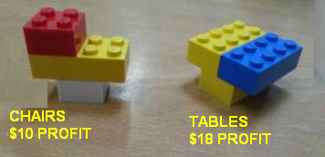
FUNKY FURNITURE!
You are the owner of a furniture shop, which specializes in full-size Lego-inspired furniture.
Your supplier can deliver 8 small components, and 6 large components each day.
How do you make the most profit?
Convince the COO (Chief Operating Officer)!
2 small
1 large
2 small
2 large

Slide 2
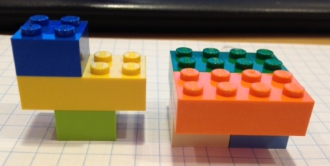
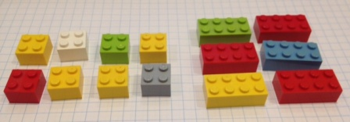

Slide 3
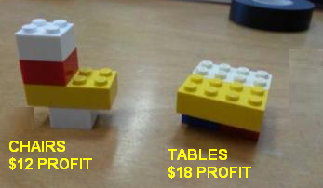
FUNKY FURNITURE!
Several years later, your shop is now a large chain. You have updated your product line:
Your supplier can deliver 1200 small components, and 800 large components each day.
How do you make the most profit?
Convince the COO!

